Slide 1
Design a basic three-tier software architecture diagram for a web application.

Slide 2
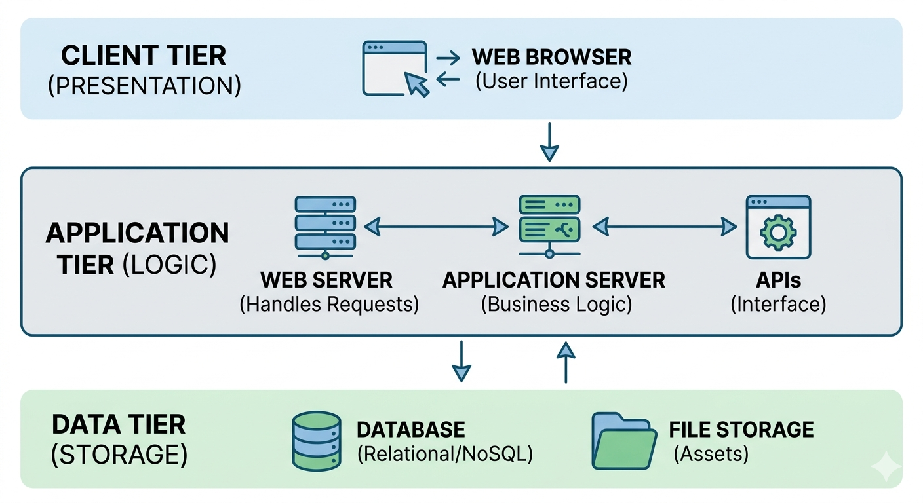

Slide 3
A three-tier architecture is a software design pattern that divides a web application into three logical and physical layers. This separation allows each tier to be developed, updated, and scaled independently, improving security and performance. vFunction +3
1. Presentation Tier (Client Layer)
The Presentation Tier is the topmost level and serves as the user interface. Medium
Purpose: Handles user interaction and displays information.
Components: Web browsers (Chrome, Safari) or mobile applications.
Technologies: Built using HTML5, CSS, and JavaScript.
Interaction: Communicates with the application tier through API calls. TechTarget +3
2. Application Tier (Logic Layer)
The Application Tier sits in the middle and acts as the "brain" of the application. Medium +1
Purpose: Processes commands, makes logical decisions, and performs calculations.
Components: Application servers (e.g., Apache Tomcat, Nginx, JBoss).
Technologies: Often written in languages like Java, Python, or C#.
Interaction: Coordinates between the presentation layer and the data layer, ensuring data is processed correctly before being stored or displayed.

Slide 4
3. Data Tier (Database Layer)
The Data Tier is the back-end layer where information is stored and managed. IBM +1
Purpose: Provides a structured way to store and retrieve data.
Components: Database management systems (DBMS).
Technologies: Common examples include MySQL, PostgreSQL, Oracle, and MongoDB.
Interaction: Responds to data requests from the application tier; it cannot be accessed directly by the presentation tier for security reasons

